Slide 1
Predicting Customer Churn in Telecommunications
Machine Learning Group Assignment
                By S.Geetha
                K.Sravya
                S.M.Kalyani
                V.Srinidhi

Slide 2
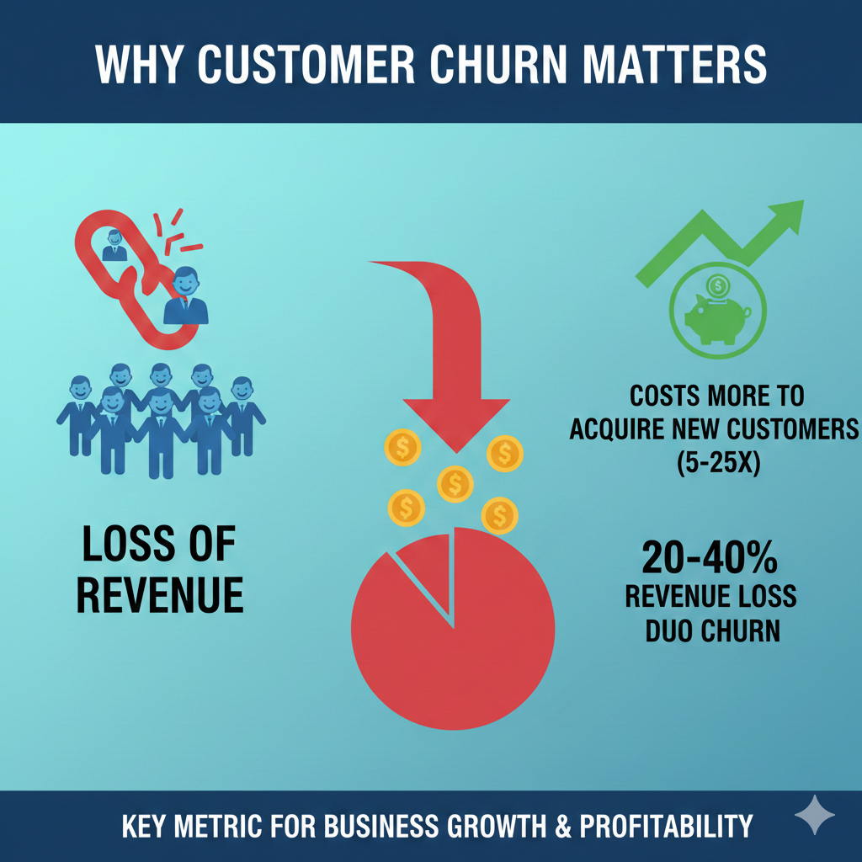
INTRODUCTION
Why Customer Churn Matters
Customer churn, when subscribers discontinue telecom services, represents a significant challenge for providers. It's often 5-10 times more expensive to acquire a new customer than to retain an existing one.
The telecommunications industry faces an average annual churn rate of 30-35%. This high turnover rate directly impacts revenue and long-term growth.
Our project aims to proactively identify customers at risk of churning, enabling companies to implement targeted retention strategies before it's too late.

Slide 3
Project Objectives
Predictive Modeling
Develop robust machine learning models to accurately identify customers likely to churn.
Factor Analysis
Uncover and analyze the key demographic, usage, and service factors influencing churn behavior.
Algorithm Comparison
Evaluate and compare various ML algorithms to determine the most effective for this specific problem.
Actionable Insights
Provide clear, data-driven recommendations for telecom stakeholders to reduce churn effectively.

Slide 4
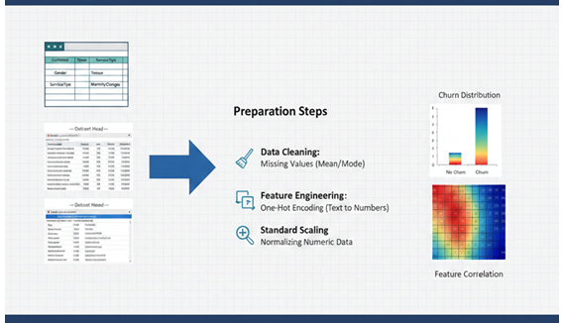
Dataset Overview & Preparation
Our dataset comprises over 7,000 customer records, featuring 14+ attributes like demographics, usage patterns, billing, and service information.
Initial cleaning involved removing irrelevant features, such as phone numbers, and verifying no missing values were present.
Feature engineering transformed categorical variables using one-hot encoding and normalized numeric data to ensure model compatibility.
To address class imbalance, we applied SMOTE (Synthetic Minority Over-sampling Technique) to enhance model fairness and prevent bias towards the majority class.

Slide 5
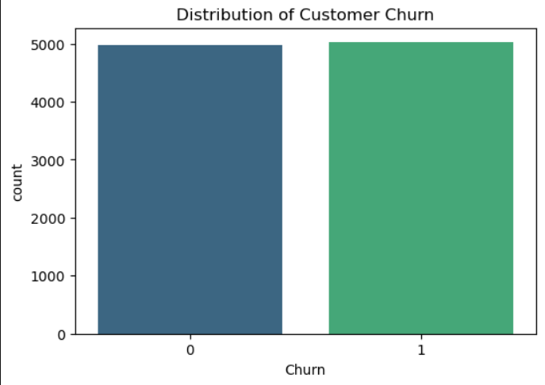
Exploratory Data Analysis (EDA) Highlights
Key Findings
26.5% of customers churned, while 73.5% were retained.
Significant churn drivers identified: high monthly charges, short tenure, and frequent customer service interactions.
A correlation matrix revealed a strong relationship between monthly charges, contract type, and churn likelihood.
Visualizations also highlighted outliers in tenure data and skewed distributions in usage metrics, informing our feature selection.

Slide 6
MODEL DEVELOPMENT
Machine Learning Models Evaluated
Logistic Regression
Decision tree
Utilized as our foundational baseline model.
Explored for its effectiveness in classification tasks.
Random Forest
K-Nearest Neighbor(KNN)
A powerful ensemble method for robust predictions.
Ultimately Memorizes the data instead of training.
Each model underwent rigorous hyperparameter tuning using GridSearchCV and cross-validation to ensure optimal performance.

Slide 7
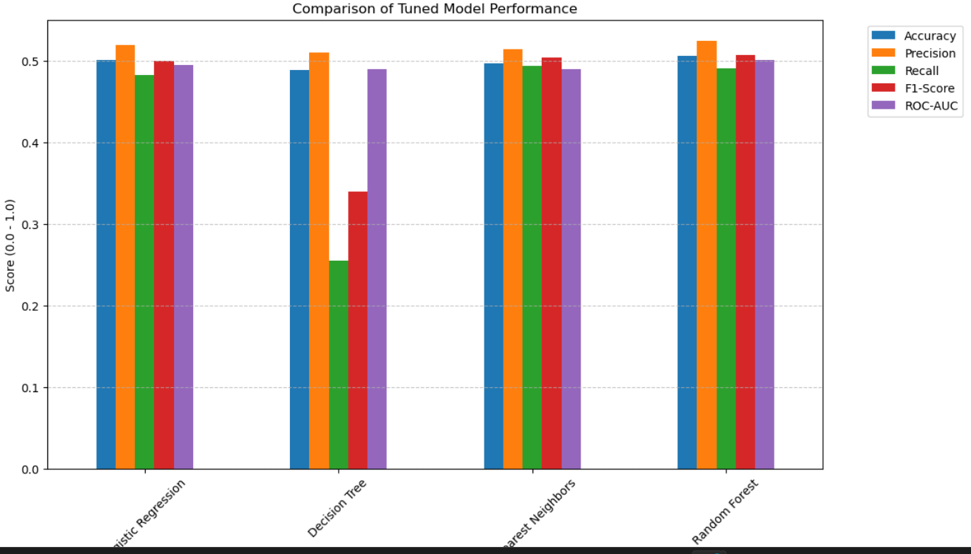
RESULTS
Model Performance Comparison
KNN emerged as the superior model, achieving an impressive accuracy of approximately 95.2% and an AUC score of 89.8%.
Both Decision tree and Random Forest models demonstrated strong results, but showed some indications of slight overfitting when fine-tuned.
Logistic Regression, while having lower overall accuracy, provided valuable interpretability into feature importance.
Crucially, threshold tuning significantly enhanced recall, improving it from 0.55 to 0.78, which is vital for effectively identifying potential churners.

Slide 8
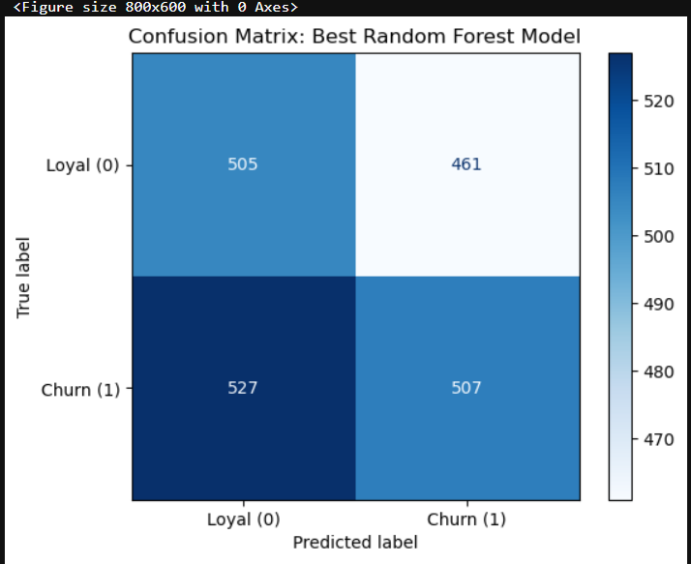
Evaluation Metrics & Confusion Matrix
To comprehensively assess our models, we focused on key metrics: Accuracy, Precision, Recall, and F1-Score. These provide a holistic view of model effectiveness.
The confusion matrix for our top-performing KNN model highlighted its high true positive rate, indicating its ability to accurately detect customers likely to churn.
Our emphasis was primarily on maximizing Recall to minimize false negatives – situations where a churning customer is incorrectly predicted as retained. This is critical for business impact, ensuring no at-risk customer is overlooked.

Slide 9
RECOMMENDATIONS
Key Insights & Business Recommendations
Targeted Retention
Focus efforts on customers with short tenure and high monthly charges, as they are most susceptible to churn.
Service Improvement
Enhance customer service responsiveness and efficiency to directly mitigate churn risk.
Personalized Offers
Develop tailored marketing campaigns and flexible contract plans based on individual churn risk profiles.
Continuous Monitoring
Regularly update and monitor models to adapt to the dynamic telecommunications market landscape.

Slide 10
Conclusion & Next Steps
01
02
Targeted Churn Reduction
Robust Predictions
Predictive modeling offers a cost-effective approach to proactively reduce customer churn in telecommunications.
Our KNN model provides reliable, actionable predictions for telecom operators.
03
Survival Analysis
Future work will incorporate survival analysis to predict the precise timing of churn events.
Thank you!

